Slide 1
Lecture 4
Research Grade CGE Models
David Roland-Holst and Samuel Evans
UC Berkeley
Computable General Equilibrium (CGE) Model Training Workshop
Workshop on Regional Economic Cooperation Database and Modeling
2-4 December 2015
CAREC Institute, Urumqi, PRC
dwrh@berkeley.edu

Slide 2
GE Modeling Applications
Livestock and Poverty – Vietnam
Remittances and Income Distribution - Kyrgyz
Infrastructure Development – Pakistan
Resources and Development - Mongolia
Asian Regionalism and Globalization - China
Reform and Growth – Myanmar
Climate Risk – Thailand
Energy Policy – India and Bangladesh
Water Resources - Vietnam

Slide 3
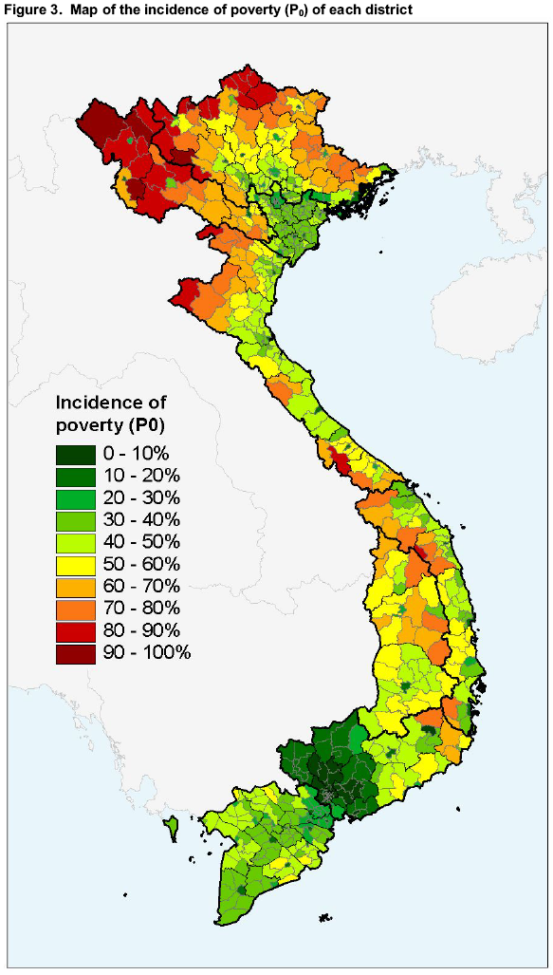
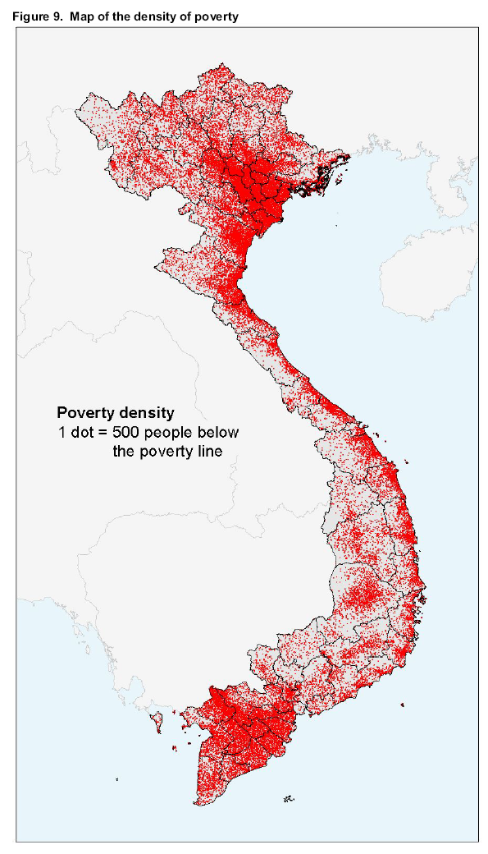
Poverty Incidence vs Poverty Density
Poverty Incidence
Poverty Density
Notes:
The majority of Vietnam’s poor are well within reach of markets, and diversification toward livestock and other marketable agriculture can facilitate their exit from poverty.
Generally, these are also more likely to be “median poor,” those with the at least the minimal productive assets needed for household enterprise development.

Slide 4

Poverty and Markets
Favorable
Unfavorable
Poverty
Specialization
Mkt. Distance
Ag TOT
Notes:
Poverty is very highly correlated with market distance and adverse terms of trade (output/input price ratios).
Farmers are in the ice business – the value of their output (and their bargaining power) declines sharply with distance.

Slide 5
Vietnam: Poultry Income
Poultry income
is far more equitably
distributed than
total income !

Slide 6
Household Income Effects of a Backyard Poultry Sale Ban

Slide 7
Remittances and Income Distribution: Kyrgyz Republic
Any external inflow can affect the variables we are talking about, but the net effect is an empirical question.
For the Kyrgyz republic, we contrast two simple scenarios:
A 10% increase in baseline remittance flows.
Scenario 1 combined with a 1% increase in total factor productivity.
NB: The results would be larger in an inter-temporal comparison, but the qualitative effects do not change.

Slide 8
Macro Results
}
}
}
}
}
}
}
}
}

Slide 9
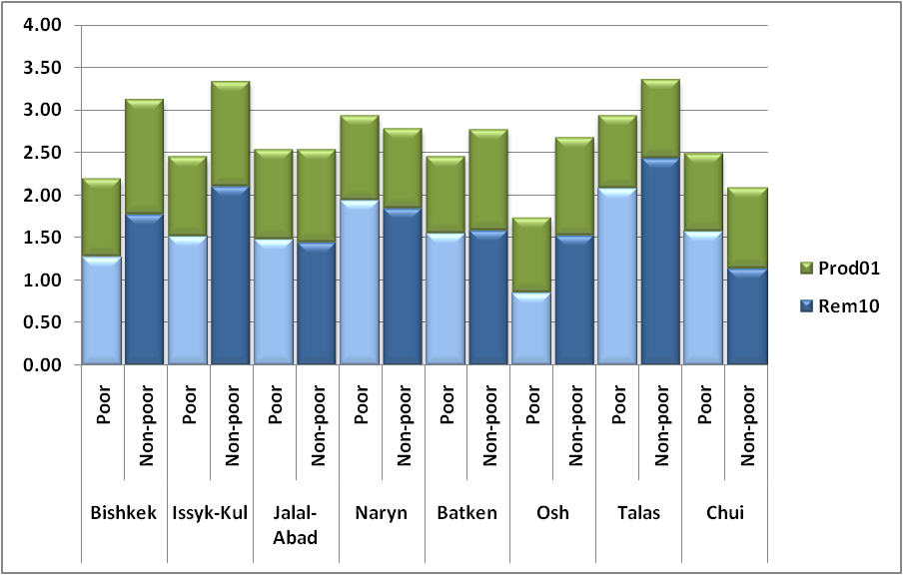
Meso Results Real Household Income
Good for the poor, but not necessarily pro-poor.

Slide 10
Infrastructure: Two Modeling Perspectives
Single country – Pakistan
More detailed incidence and adjustment
Fiscal/finance experimentation
Targeting
Multi-country – Kazakhstan in CAREC (next lecture)
Captures spillovers and shared growth interactions
Supports multilateral policy dialogue and financial analysis

Slide 11
Pakistan CGE and SAM
CGE – a “plain vanilla” single country dynamic GE model
SAM
82 domestic production activities/ 82 commodities
18 factors of production
22 labour categories
3 Capital Types
Land and Water Resources
19 household types
1 enterprises (Private, Public, and Foreign)
State (detailed fiscal instruments including NCHWIP project finance)
Consolidated capital account
A Rest of World aggregate trading partner

Slide 12
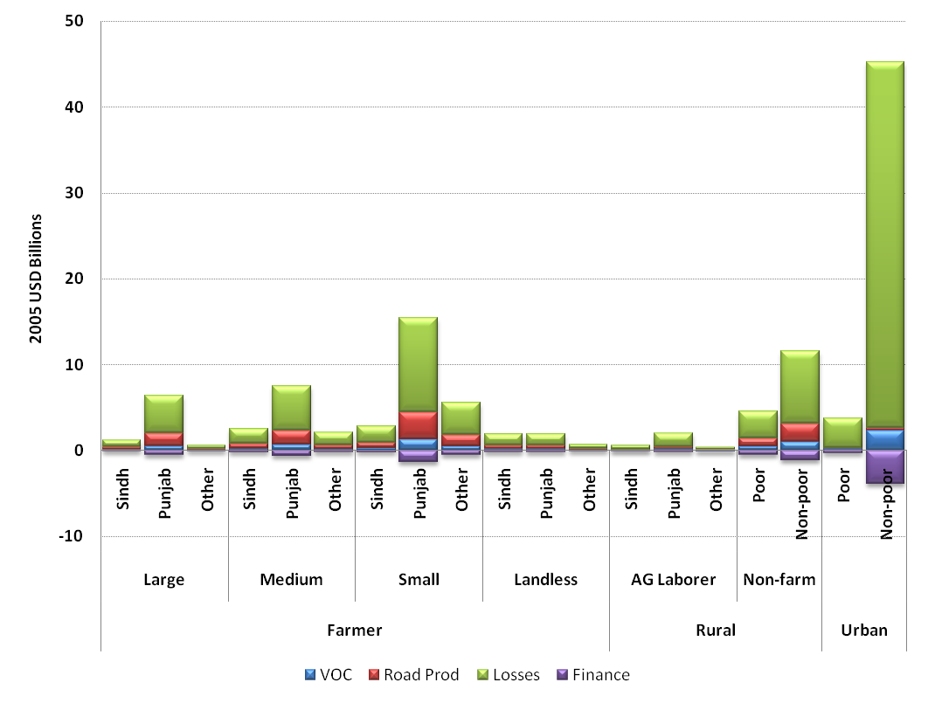
Pakistan Household Real Income Growth (cumulative Over Baseline, 2006-2030)
Punjab has more transport-intensive agricultural products.
For the Urban Non-poor, income and expenditure effects combine to confer transport benefits.

Slide 13
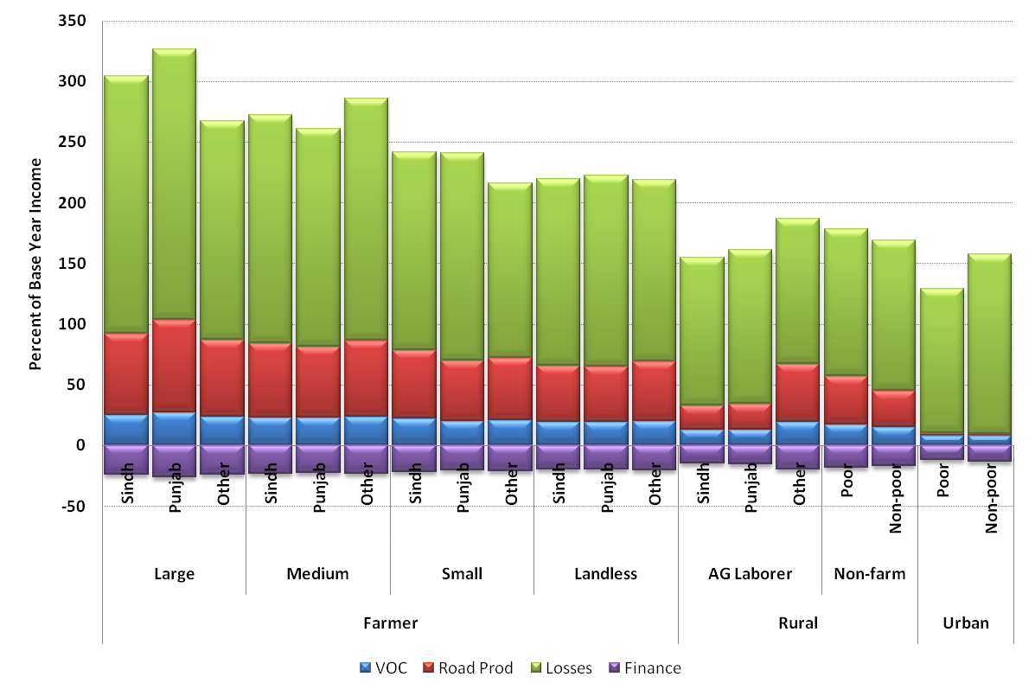
Pakistan Household Income Growth (percent of 2006)
The project is generally pro-poor, with small and landless rural farm households gaining more than Non-poor Non-farm and Urbanites.

Slide 14
Resources and Development: Mongolia
Investment Project Scenarios

Slide 15
Real GDP Impacts (percent change from Baseline)

Slide 16
Macroeconomic Impacts

Slide 17
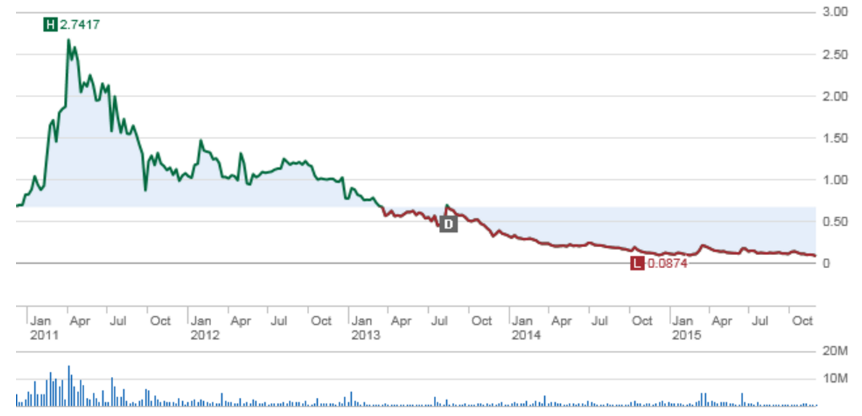
What’s wrong with this picture? What policy makers can’t control.
Wholesale Copper Prices

Slide 18
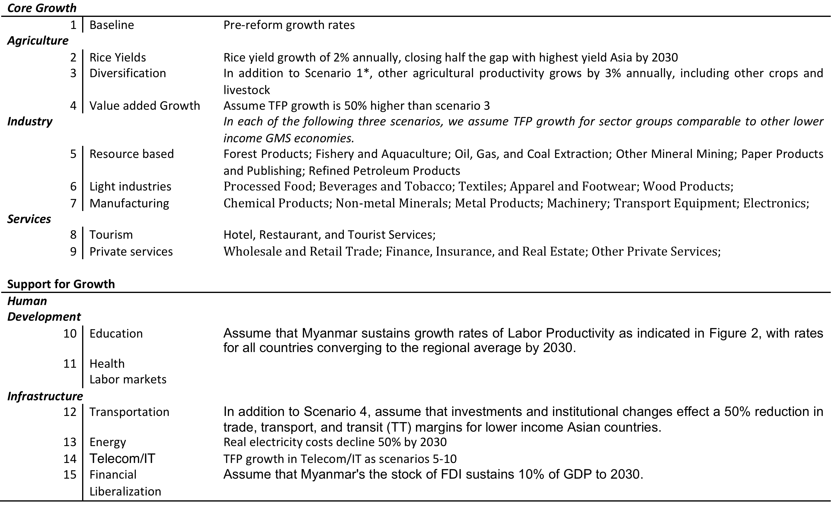
Policy Reform and Growth: Myanmar

Slide 19
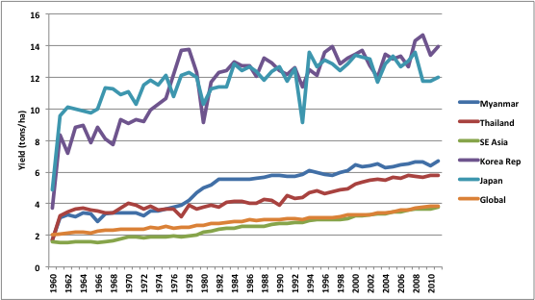
Rice Yields by Country/Region 1960-2010
Source: International Rice Research Institiute

Slide 20
Factor Productivity Growth in Asia Percent per annum,1999-2008
Source: OECD, World Bank

Slide 21
Real GDP Growth by Scenario (indexed to 2010=100)
Source: Authors’ estimates.

Slide 22
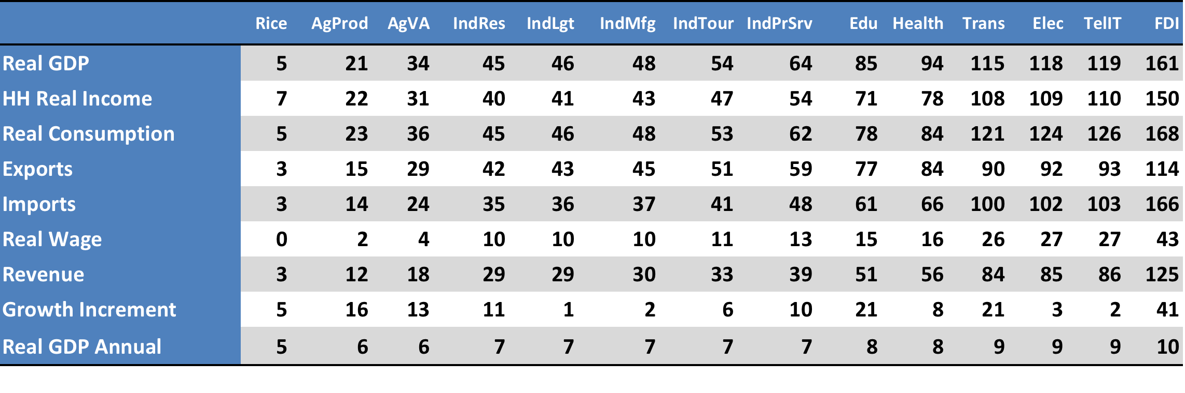
Macroeconomic Aggregates (percent difference from Baseline in 2030)
Source: Authors’ estimates. Notes: Rows 1-7 measure percentage scenario differences from the Baseline in 2030. Growth Increment is the percent 2030 contribution to real GDP from each scenario, taken in sequence. Row 9 presents the annual average growth of real GDP over the period 2010-30, for each scenario.

Slide 23
Overall and Incremental GDP Growth by Scenario (percent difference from Baseline in 2030)
Source: Authors’ estimates.

Slide 24
Sectoral Growth Dynamics Under Two Scenarios
Source: Authors’ estimates.

Slide 25
Climate Risk: Thailand Recent Climate History: 1980-2010
Growing season temperature patterns are shifting, rainfall is increasing.

Slide 26
Sources of Vulnerability: Water

Slide 27
Indicative Scenarios
NB: Scenarios are cumulative.
Notes:
For today’s presentation, we offer the most inclusive efficiency scenario for illustration. Qualitative effects of all the others will be the same from a macro perspective.

Slide 28
Macroeconomic Impacts
Percent changes from Baseline in 2050
Losses not catastrophic, but large enough to justify significant adaptation investments.
Generally consistent with Stern, et al., but results are smaller because many climate impacts are omitted.
Rice impact probably underestimated because of subsistence.
Most serious losses from non-commodity foods and infrastructure.

Slide 29
Household Impacts
Percent changes from Baseline in 2050.
Averages mask significant differences in adjustment costs.
The poor bear the highest burden.

Slide 30
Rice Yields: Climate Model Comparisons
Notes:
Statistical model predicted yield change across GCM models. Each box represents a different GCM and the dispersion is across rice growing areas. Under the linear model (blue) all areas are expected to lose potential yields from A1B climate change, however, even by 2050 most losses are projected to be less than 5% of potential rice yields. Under the piecewise-linear model (green),

Slide 31
Rice Growing Area Over the Negative Threshold for Maximum Temperature

Slide 32
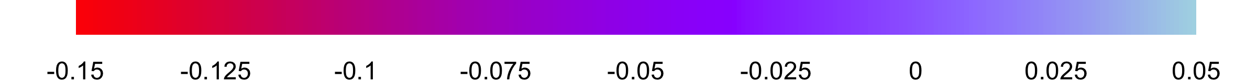
Yield Changes: A1B Scenario

Slide 33
Asian Regionalism and Globalization: China
Head-to-head export global competition with China will continue to be difficult.
More attention should be given to leveraging opportunities presented by East Asia’s fastest growing internal market.
In these areas, the best strategy for East and Southeast Asia is to pursue globalism through more comprehensive regionalism.

Slide 34
Asian Trade Triangle 2000
China
?
Rest of
E&SE Asia
Rest of
World

Slide 35
Asian Trade Triangle 2020
China
Rest of
E&SE Asia
Rest of
World

Slide 36
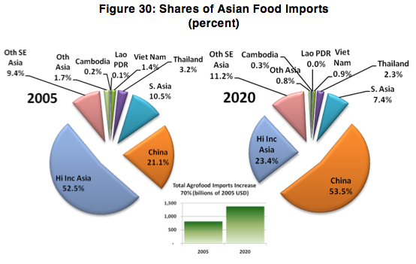
Example: Recommendations for China’s13th Five Year Plan
In two decades, rising income and resource constraints have moved China from self-sufficiency to become Asia’s largest food importer.
To improve long-term food security, China should step up supply side commitments to overseas agrifood partnership.
Particular attention should be given to lower income Asian neighbors. Where agrifood productivity remains low, China can promote self-directed poverty reduction and greater food security for on both sides.

Slide 37
Real GDP by DMC, Cumulative Percent Change 2010-2030

Slide 38
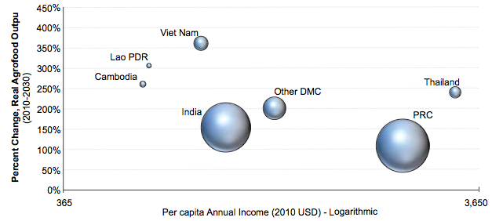
Agrofood Productivity Growth can be Pro-poor

Slide 39
Energy Policy: India and Bangladesh Domestic and International Gas Prices
Source: Author estimates from Petrobangla and IEA data.

Slide 40
Food or Energy Security?
For countries with low income majorities, food price risk is more important than energy price risk – for this group there are two different policy approaches
Countries with significant domestic biofuel potential can consider supply side solutions to energy needs
The others will remain price takers in energy markets, and should not divert agrofood potential to energy production
For the latter group, the priority should be to offset livelihood risk from food prices, promoting agrofood productivity to reduce food costs and, indirectly, any adverse real income effect from higher energy prices.

Slide 41
Beware of Trade-offs: Low food prices are more important to the poor than low energy prices.
50% of World Population
Source: World Bank LSMS data archive.
Notes:
So we can do both energy and food, and should to avert any domestic resource rivalry.
The rural poor really can’t “compete” for water with large public/private works, and if water scarcity drives up food costs, both rural and urban poor will suffer.
Far better to promote integrated water development that harvests national energy resources while promoting agrofood productivity growth.
On average, lower income groups spend seven times as much on food as energy, higher incomes groups only about twice as much.

Slide 42
India: Scenarios for Energy and Food Security
Baseline: Reference case, global oil and gas prices constant.
S1: Global oil and gas prices rise 50% over the period 2010-2030.
S2: Scenario 1 with biodiesel and ethanol standards (USA, EUR, IND)
S3: Scenario 2 with 1 percent annual energy efficiency gains.
S4: Scenario 3 with 1 percent agrofood productivity growth.

Slide 43
Macroeconomic Results: India (2030 change from baseline)
Oil Price
Biofuel
EE
Ag Prod

Slide 44
Bangladesh: Energy Price Reform
Generally speaking, the patterns of price adjustment that emerge from the EQL scenario suggest that energy costs will rise for the economy as a whole, conferring small welfare costs under existing patterns of technology use.
If however, the economy were to react to higher energy prices by increasing efficiency, these costs could be averted.
Historically, energy subsidies in most countries have been associated with low efficiency levels, while higher prices induce conservation behavior and technology adoption that substantially improve energy efficiency, saving money while stimulating innovation and growth.

Slide 45
Fertilizer Exemption
With our without EE improvements, exempting the Fertilizer sector would more than offset the aggregate welfare costs of natural gas price reform.
The reason for this is simple, fertilizer is not merely an input to agriculture but something that increases its productivity.
It is important that this indirect (gas input) subsidy not promote unsustainable patterns of fertilizer application, but making this productivity tool less expensive has pervasive cost of living benefits.

Slide 46
Energy Trade
Many have observed that coal would be a more cost-effective fuel for Bangladesh’s electric power sector.
Our results (Coal50) strongly support this reasoning, suggesting that gas has a high domestic and international opportunity cost, and that using coal in the electric power would free the government from subsidies without as much attendant energy cost escalation.
Indeed, making coal a primary electric power fuel would reduce domestic gas costs and allow it to fuel higher real consumption, savings, private and public investment.
Switching to more cost-effective electric power, while reforming gas prices to respond to market forces would push real Bangladeshi GDP more than 10% higher by 2030.

Slide 47
Gas Exports
Gas may be a public resource, but selling it can finance much needed public goods and services.
To assess this opportunity cost, we assume Bangladesh sells up to 10% of total gas supply on the international market.
Our results suggest that even modest export concessions would significantly increase the country’s domestic income, employment, and trade.
We estimate that this policy could generate about $11B over 20 years, increasing national wealth while promoting more sustainable domestic resource use.
Combining Gas export with Coal import (Scenario 6) overcomes rising gas prices and further enhances growth.

Slide 48
Scenarios for Energy Prices, Trade, and Investment

Slide 49
Macroeconomic Results (percentage change from Baseline in 2030)
Source: Author estimates.

Slide 50
Household Detail in the 2010 SAM

Slide 51
Household Impacts: Pricing Scenarios
Source: Author estimates.

Slide 52
Household Impacts: Trade and Investment Scenarios
Source: Author estimates.

Slide 53
Water Resources: Vietnam Growth and Urbanization

Slide 54
Water Policy Scenarios

Slide 55
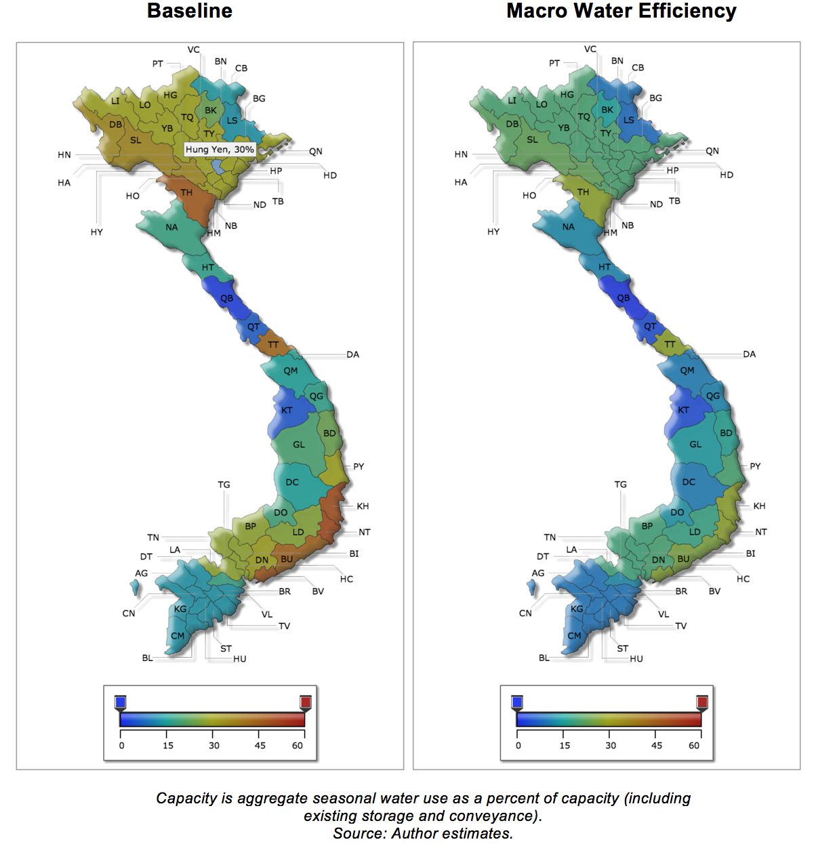
Efficiency Can Help Growth of Water Demand, 2010-2030 (percent)

Slide 56
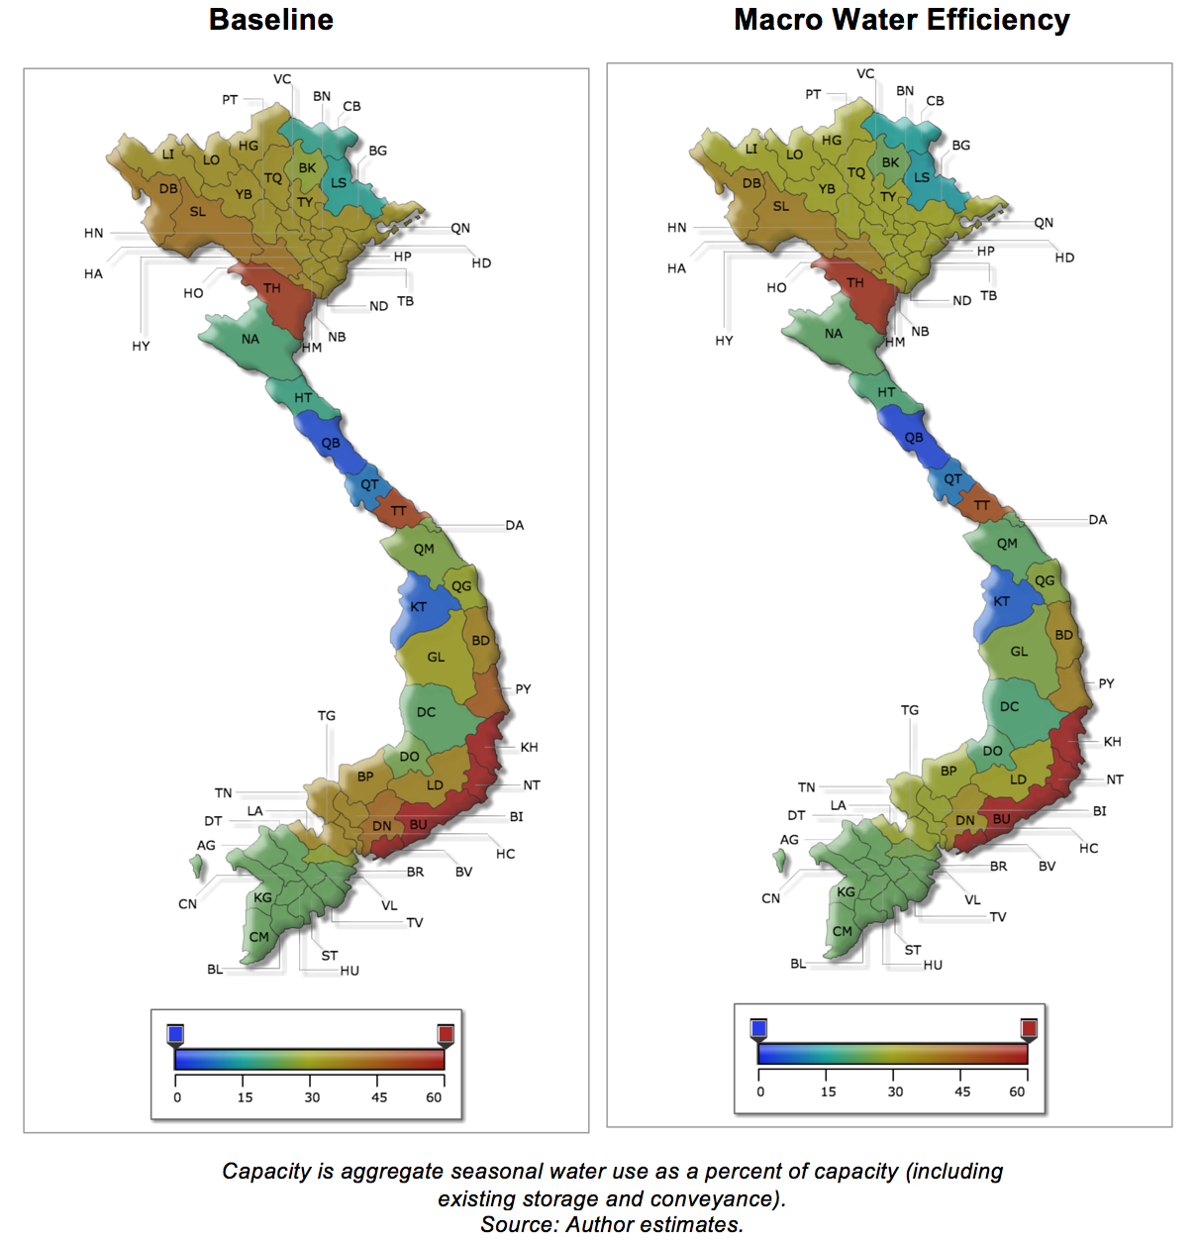
But not in the dry season: Storage is essential

Slide 57
Discussion

Slide 58
Discussion

